Slide 1
Race, Racism and Racial Inequalities in Health
David R. Williams, PhD, MPH
Florence & Laura Norman Professor of Public Health
Professor of African & African American Studies and of Sociology
Harvard University

Slide 2
A Driver of Early Interest in
Racism and Health
Racial/ethnic Disparities Persist
Earlier onset of Disease
Greater severity of Disease
Residual Racial Differences at every SES level

Slide 3
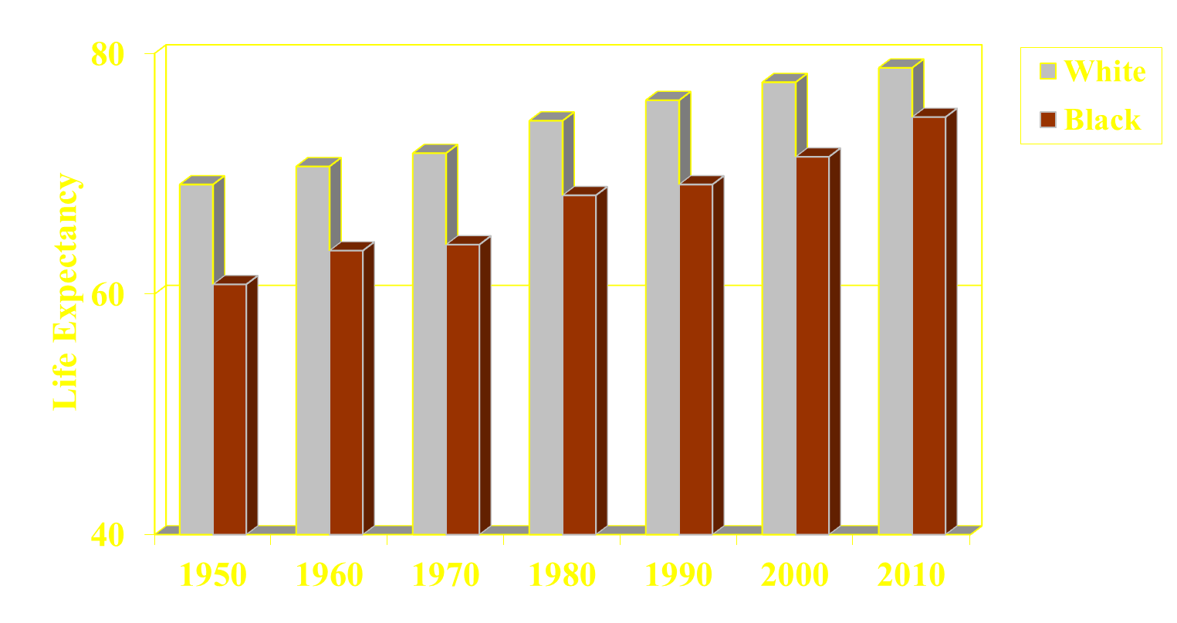
Life Expectancy Lags, 1950-2010
77.6
78.8
76.1
74.4
74.7
70.6
71.7
71.4
69.1
68.2
69.1
63.6
64.1
60.8
Source: NCHS, Health United States, 2013

Slide 4
A Striking Pattern
  Accelerated aging - earlier onset of disease

Slide 5
Neonatal Mortality Rates (1st Births), U.S.
Geronimus & Bound, 1991; National Linked Birth/Death Files, 1983

Slide 6
Biological Weathering
Chronological age captures duration of exposure to risks for groups living in adverse living conditions
Blacks experience greater physiological wear and tear, and are aging, biologically, faster than whites
It is driven by the cumulative impact of repeated exposures to psychosocial, physical and chemical stressors in their residential, occupational and other environments, and coping with these stressors
Compared to whites, blacks experience higher levels of stressors, greater clustering of stressors, and probably greater duration and intensity of stressors
Geronimus et al, Hum Nature, 2010 ; Sternthal et al 2011

Slide 7
Allostatic Load
10 biomarkers High-risk thresholds *
Systolic blood pressure 127 mm HG
Diastolic blood pressure 80 mm HG
Body Mass Index 30.9
Glycated hemoglobin 5.4%
Albumin 4.2 g/dL
Creatinine clearance 66 mg/dL
Triglycerides 168 mg/dL
C-reactive protein 0.41 mg/dL
Homocysteine 9 μmol/L
Total cholesterol 225
* = < 25th percentile for creatinine clearance; >75th percentile for others
Geronimus, et al., AJPH, 2006

Slide 8
Mean Score on Allostatic Load by Age
Geronimus, et al., AJPH, 2006

Slide 9
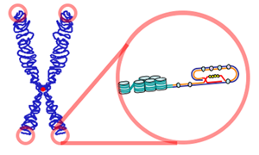
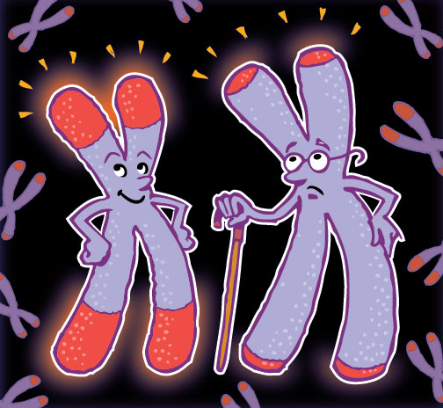
Racial Differences in Telomere Length
Telomeres are sequences of DNA at end of chromosome. Telomere length is viewed as an overall marker of biological aging
Study found that Black women had shorter telomeres than White women
At same chronological age, black women had accelerated biological aging of about 7.5 years
Geronimus et al., Human Nature, 2010

Slide 10
Making Sense of Racial Disparities in Health?

Slide 11
Socioeconomic Status (SES) is a central determinant of the distribution of valuable resources in society

Slide 12
SAT = Scholastic Aptitude Test

Slide 13
OR
Student Affluence Test?

Slide 14
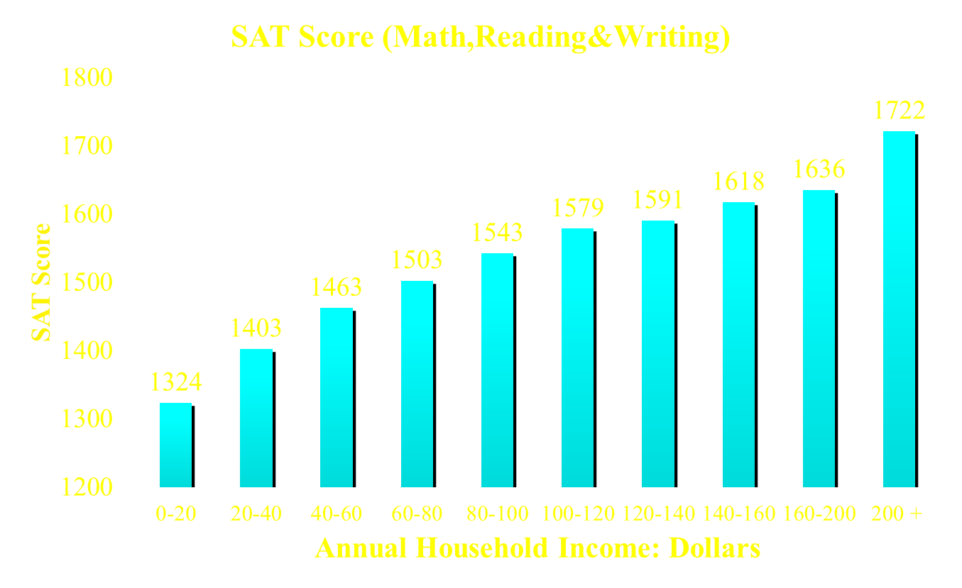
SAT SCORE by Family Income
Fair Test, College Board, Wall Street Journal, Oct 7th, 2014

Slide 15
Relative Risks of All-Cause Mortality by Household
Income Level: U.S. Panel Study of Income Dynamics
P. McDonough, Duncan, Williams, & House, AJPH, 1997

Slide 16
There are Large Racial/Ethnic Differences in SES

Slide 17
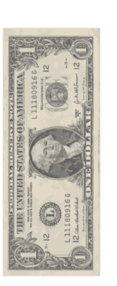






Median Household Income and Race, 2013
Racial Differences in Income are Substantial:
1 dollar
1.15 dollar
70 cents
59 cents
White
Asian
Hispanic
Black
U.S. Census Bureau (DeNavas – Walt and Proctor 2014)

Slide 18
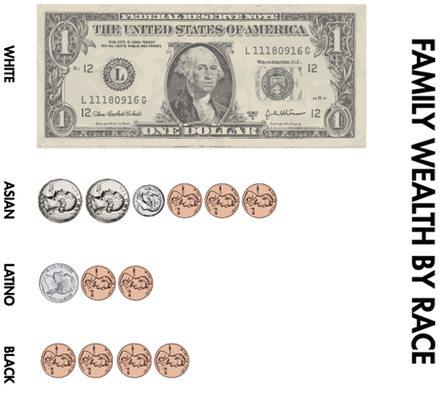
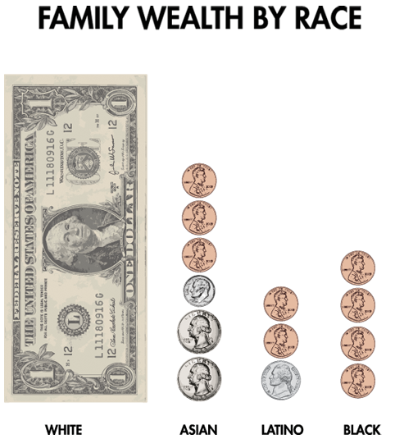


Median Wealth and Race, 2011
For every dollar of wealth that Whites have,
Asians have 81 cents
Blacks have only 6 cents
Latinos have only 7 cents
U.S. Census Bureau, 2014

Slide 19
Added Burden of Race

Slide 20
Life Expectancy At Age 25
Group | White | Black | Difference
All | 53.4 | 48.4 | 5.0
Murphy, NVSS 2000

Slide 21
Life Expectancy At Age 25
Group | White | Black | Difference
All Education | 53.4 | 48.4 | 5.0
a. 0-12 Years | 50.1
b. 12 Years | 54.1
c. Some College | 55.2
d. College Grad | 56.5
Difference | 6.4
Murphy, NVSS 2000; Braveman et al. AJPH; 2010, NLMS 1988-1998

Slide 22
Life Expectancy At Age 25
Group | White | Black | Difference
All Education | 53.4 | 48.4 | 5.0
a. 0-12 Years | 50.1 | 47.0
b. 12 Years | 54.1 | 49.9
c. Some College | 55.2 | 50.9
d. College Grad | 56.5 | 52.3
Difference | 6.4 | 5.3
Murphy, NVSS 2000; Braveman et al. AJPH; 2010, NLMS 1988-1998

Slide 23
Life Expectancy At Age 25
Group | White | Black | Difference
All Education | 53.4 | 48.4 | 5.0
a. 0-12 Years | 50.1 | 47.0 | 3.1
b. 12 Years | 54.1 | 49.9 | 4.2
c. Some College | 55.2 | 50.9 | 4.3
d. College Grad | 56.5 | 52.3 | 4.2
Difference | 6.4 | 5.3
Murphy, NVSS 2000; Braveman et al. AJPH; 2010, NLMS 1988-1998

Slide 24
Why Does Race Still Matter?
Could racism be a critical missing piece of the puzzle to understand the patterning of racial disparities in health?

Slide 25
Racism and Health: Mechanisms
Institutional discrimination can restrict socioeconomic attainment and group differences in SES and health.
Segregation can create pathogenic residential conditions.
Discrimination can lead to reduced access to desirable goods and services.
Internalized racism (acceptance of society’s negative characterization) can adversely affect health.
Racism can create conditions that increase exposure to traditional stressors (e.g. unemployment).
Experiences of discrimination may be a neglected psychosocial stressor.

Slide 26
The Pervasiveness of Discrimination
Discrimination
Getting insurance
Buying a home
Renting an
apartment
Hailing a taxi
Obtaining bank loans
Receiving a promotion
Quality of medical care
Suspended from
preschool
Purchasing
a car
Getting a job
Pulled over by
police
Cost of bail
Arrested for drug–related crimes

Slide 27
Race, Criminal Record, and Entry-level Jobs in NY, 2004
Devah Pager et al Am Soc Review, 2009; 169 employers

Slide 28
Perceived Discrimination:
Experiences of discrimination may be a neglected psychosocial stressor

Slide 29
MLK Quote
“..Discrimination is a hellhound that gnaws at Negroes in every waking moment of their lives declaring that the lie of their inferiority is accepted as the truth in the society dominating them.”
Martin Luther King, Jr. [1967]

Slide 30
2009 Review
115 studies in PubMed between 2005 and 2007
Some longitudinal data
Attention to the severity and course of disease
Many studies of Asians and a few studies of whites
International studies:
-- national: New Zealand, Sweden, & South Africa
-- Australia, Canada, Denmark, the Netherlands, Norway, Spain, Bosnia, Croatia, Austria, Hong Kong, and the U.K.
Association of discrimination with health robust after adjustment for psychological confounders
Williams & Mohammed, J Behav Med 2009

Slide 31
Perceived Discrimination and Health
Discrimination is associated with elevated risk of
-- diabetes risk (Hemoglobin A1c)
-- substance use (smoking, alcohol, other drugs)
-- breast cancer incidence
-- uterine myomas (fibroids)
-- subclinical carotid artery disease (IMT; intima-media thickness
-- Delays in seeking treatment, lower adherence to treatment regimes, lower rates of follow-up
Discrimination accounts, in part, for racial/ethnic disparities in health, in U.S., and elsewhere
Williams & Mohammed, J Behav Med 2009

Slide 32
Discrimination as Life Events: Major Experiences
At any time in your life, have you ever been unfairly fired?
For unfair reasons, have you ever not been hired for a job?
Have you ever been unfairly denied a promotion?
Have you ever been unfairly stopped, searched, questioned, physically threatened or abused by the police?
Have you ever been unfairly discouraged by a teacher or advisor from continuing your education?
Have you ever been unfairly prevented from moving into a neighborhood because the landlord or a realtor refused to sell or rent you a house or apartment?
Have you ever moved into a neighborhood where neighbors made life difficult for you or your family?
Have you ever been unfairly denied a bank loan?
Have you ever received service from … a plumber or car mechanic that was worse than what other people get?

Slide 33
Major Experiences of Discrimination: Additional Questions
What do you think was the main reason for this experience?
When was the last time this happened?
How many times has this happened during your lifetime?

Slide 34
Chronic Stress: Every Day Discrimination
In your day-to-day life how often do the following things happen to you?
You are treated with less courtesy than other people.
You are treated with less respect than other people.
You receive poorer service than other people at restaurants or stores.
People act as if they think you are not smart.
People act as if they are afraid of you.
People act as if they think you are dishonest.
People act as if they’re better than you are.
You are called names or insulted.
You are threatened or harassed.
What do you think was the main reason for these experiences
Detroit Area Study 1995; Williams et al. 1997

Slide 35
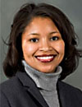
Discrimination & Health: Tene Lewis
Everyday Discrimination: positively associated with:
-- coronary artery calcification (Lewis et al., Psy Med, 2006)
-- C-reactive protein (Lewis et al., Brain Beh Immunity, 2010)
-- blood pressure (Lewis et al., J Gerontology: Bio Sci & Med Sci 2009)
-- lower birth weight (Earnshaw et al., Ann Beh Med, 2013)
-- cognitive impairment (Barnes et al., 2012)
-- poor sleep [object. & subject.] (Lewis et al, Hlth Psy, 2012)
-- mortality (Barnes et al., J Gerontology: Bio Sci & Med Sci, 2008).
-- visceral fat (Lewis et al., Am J Epidemiology, 2011)

Slide 36
How much does discrimination contribute to the declining health status of immigrants over time?

Slide 37
Acculturation Stressors and health
A study of migrant Mexican workers in Fresno, CA
Acculturation stress: stressors linked to discrimination, legal status and problems speaking English.
Acculturation stressors:
- inversely related to physical & mental health
- partially accounted for declines in health with years in the U.S.
- had a more severe negative effect on migrants who were more acculturated than those who were less acculturated.
Finch, Frank & Vega 2004 Int Migration Rev

Slide 38
Macro-Stressors
Large-scale societal events such as natural disasters that can be stressful for individuals
Major negative race-related events can also be macro-stressors
Research has also found that historical trauma, traumatic events experienced by Native American communities in the past, can reach across generations and adversely affect the physical and mental health of contemporary Native Americans (Walters et al., 2011).

Slide 39
Duke University Lacrosse Team Incident
In 2006, a black woman accused white male members of Duke team of racial derogation, rape and violence
Racially divisive media coverage & rhetoric followed
Duke’s black students were stressed and had concerns about their safety
An experimental study at Duke found that, compared to students who participated in the experiment before the Lacrosse team incident, after media attention to the incident, black students, especially females, had higher levels of cortisol and were unresponsive to an experimental task
Understudied: health consequences of hostile environs
Richman & Jonassaint, Annals of Behavioral Med, 2008

Slide 40
Arab American Birth Outcomes
Non race-related stressors can be racialized in ways that can generate racial/ethnic discrimination
September 11 terorist attacks an example
Well-documented increase in discrimination and harassment of Arab Americans after 9/11/2001
Arab American women in California had an increased risk of low birthweight and preterm birth in the 6 months after Sept. 11 compared to pre-Sept. 11
Other women in California had no change in birth outcome risk, pre-and post-September 11
Lauderdale, 2006

Slide 41
Perceived Threat of Discrimination:
Discrimination, like other stressors, can affect health through both actual exposure and the threat of exposure

Slide 42
Heightened Vigilance Scale
In dealing with the experiences that you just told me about, how often do you
  1. Think in advance about the kind of problems that you are likely to experience?
  2. Try to prepare for possible insults before leaving home?
  3. Feel that you always have to be careful about your appearance (to get good service or avoid being harassed)?
  4. Carefully watch what you say and how you say it?
  5. Carefully observe what happens around you?
  6. Try to avoid certain social situations and places?
Williams (DAS 1995) in Clark et al., J Adol Health, 2006

Slide 43
Heightened Vigilance and Health
Blacks have higher levels of vigilance
Vigilance predicts elevated risk of depression and contributes to black-white disparity in depression
Vigilance predicts elevated risk of sleep difficulties, independent of income and education. Disparity completely attenuated when adjusted for vigilance
As vigilance increased, the racial/ethnic gap in hypertension widened for Blacks and Hispanics
Vigilance remains predictive of hypertension when adjusted for hypertension risk factors & discrimination
LaVeist et al J Soc Iss, 2014; Hicken et al R & Soc Prob 2013; Hicken et al. AJPH, 2014

Slide 44
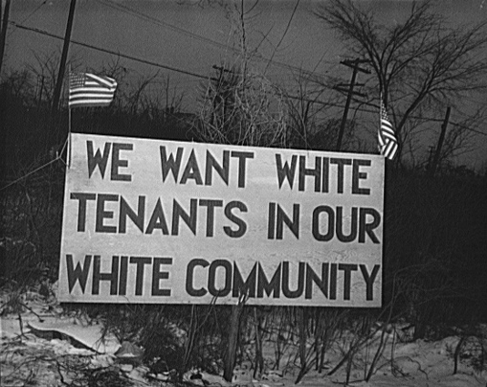
Place Matters
Segregation remains
as a legacy of racism
Segregation affects
health in multiple ways

Slide 45
How Segregation Can Affect Health
Segregation determines SES by affecting quality of education and employment opportunities.
Segregation can create pathogenic neighborhood and housing conditions.
Conditions linked to segregation can constrain the practice of health behaviors and encourage unhealthy ones.
Segregation can adversely affect access to medical care and to high-quality care.
Williams & Collins, Pub Health Reports, 2001

Slide 46
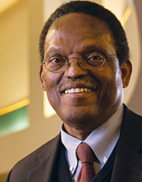
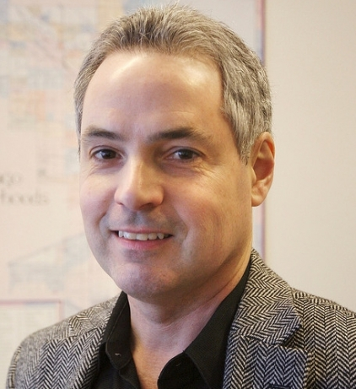
Racial Differences in Residential Environment
In the 171 largest cities in the U.S., there is not even one city where whites live in equal conditions to those of blacks
“The worst urban context in which whites reside is considerably better than the average context of black communities.”
Sampson & Wilson 1995

Slide 47
Residential Segregation and SES
One national study found that if we eliminated segregation we would completely erase black-white differences in
  Income
  Education
  Unemployment
And reduce racial differences in single motherhood by two-thirds
Cutler, Glaeser & Vigdor, 1997

Slide 48
Discrimination in Medical Care

Slide 49
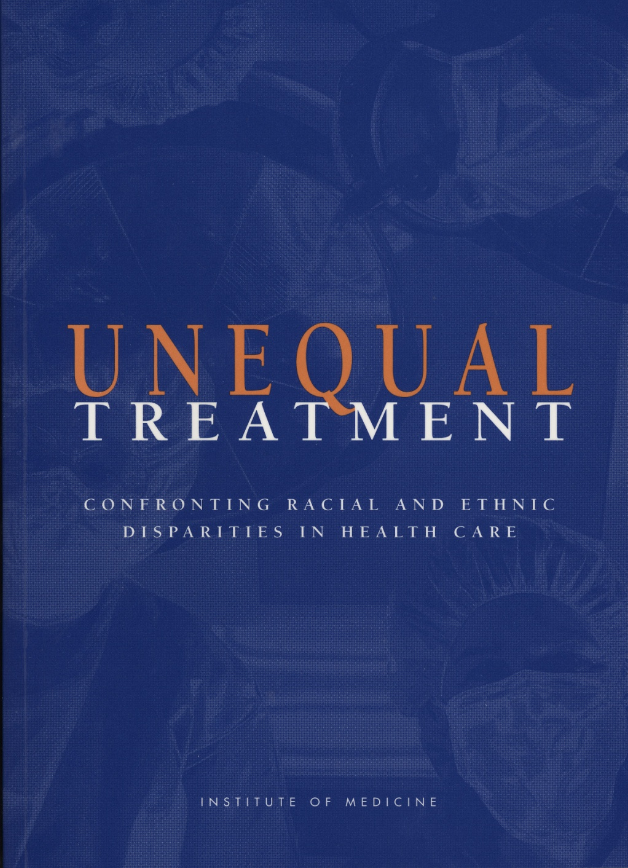

Slide 50
Race and Medical Care
Across virtually every therapeutic intervention, ranging from high technology procedures to the most elementary forms of diagnostic and treatment interventions, minorities receive fewer procedures and poorer quality medical care than whites.
These differences persist even after differences in health insurance, SES, stage and severity of disease, co-morbidity, and the type of medical facility are taken into account.
Moreover, they persist in contexts such as Medicare and the VA Health System, where differences in economic status and insurance coverage are minimized.
Institute of Medicine, 2002

Slide 51
Ethnicity and Pain Medicine
Todd et al., JAMA, 1993

Slide 52
Ethnicity and Pain Medicine
Todd et al., Ann Emerg Med, 2000

Slide 53
Why Race Still Matters
Cultural Racism Matters
It is deeply embedded in our culture

Slide 54
Stereotypes in Our Culture
BEAGLE (Bound Encoding of the Aggregate Language Environment) Project contains about 10 million words from a sample of books, newspapers, magazine articles, etc.
A good representation of American culture
Equivalent to what the average college-level student has read in her lifetime
Statistically analyzed the associative strength between pairs of words
Provides estimate of how often Americans have seen or heard words paired over their lifetime
Verhaeghen et al. British J Psychology, 2011

Slide 55
Stereotypes in Our Culture
BLACK poor .64
BLACK violent .43
BLACK religious .42
BLACK lazy .40
BLACK cheerful .40
BLACK dangerous .33
WHITE wealthy .48
WHITE progressive .41
WHITE conventional .37
WHITE stubborn .32
WHITE successful .30
WHITE educated .30
FEMALE distant .37
FEMALE warm .35
FEMALE gentle .34
FEMALE passive .34
MALE dominant .46
MALE leader .31
MALE logical .31
MALE strong .31
Verhaeghen et al. British J Psychology, 2011

Slide 56
Stereotypes in Our Culture
BLACK poor .64
BLACK violent .43
BLACK religious .42
BLACK lazy .40
BLACK cheerful .40
BLACK dangerous .33
WHITE wealthy .48
WHITE progressive .41
WHITE conventional .37
WHITE stubborn .32
WHITE successful .30
WHITE educated .30
BLACK charming .28
BLACK merry .28
BLACK ignorant .27
BLACK musical .26
WHITE ethical .28
WHITE greedy .22
WHITE sheltered .21
WHITE selfish .20
Verhaeghen et al. British J Psychology, 2011

Slide 57
Unconscious Discrimination
When one holds a negative stereotype about a group and meets someone who fits the stereotype s/he will discriminate against that individual
Stereotype-linked bias is an
  Automatic process
  Unconscious process
It occurs even among persons who are not prejudiced

Slide 58
Undoing Racism
Dismantling Institutional Racism

Slide 59
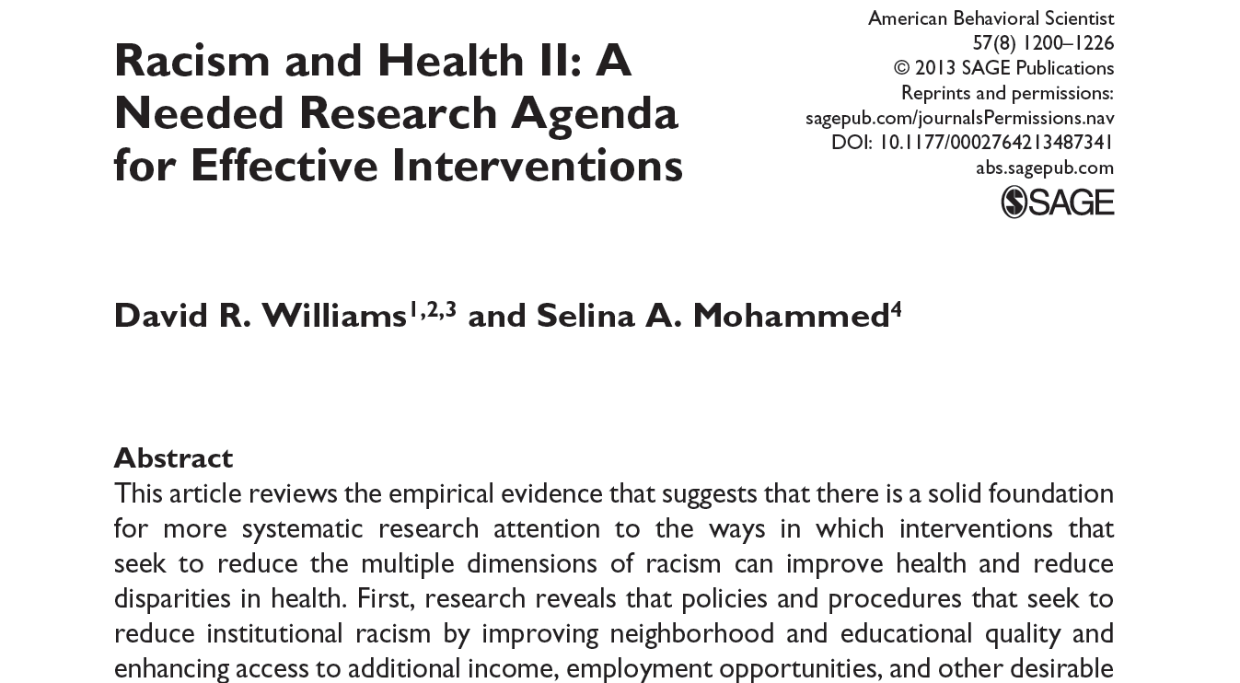

Slide 60
Racism as a System: Implications
Disparities in one societal domain are not independent of those in other domains
Racism is a set of dynamically related components of subsystems.
There is reciprocal causality of disparities across domains
Disparities in one domain are a product of causal processes across multiple subsystems
“It is impossible” to come up with remedies for disparities if we fail to acknowledge and address the interdependence across domains
Reskin, Ann Review of Sociology, 2012

Slide 61
Racism as a System
Arrows reflect emergence of racism and the effects of subsystems (white arrows)
Labor Market & Income
Education
Criminal Justice System
Racism
School Segregation
Health Care Sys
Residential Segregation
Credit Markets
Housing Market
Adapted from Reskin, Ann Rev Sociology, 2012

Slide 62
Options for Reducing Racial Inequalities
An exogenous force that acts on every subsystem: authoritative entity with mandate to act
Act on leverage points
  -- Residential segregation is one
Removing institutions from the discrimination system
  -- Success of the Army
Increasing accountability, reducing discretion
Reskin, Ann Review of Sociology, 2012

Slide 63
Implications for Reducing Disparities
Effective solutions to improve health need to:
Be comprehensive
Build more health into healthcare
Start early
Address life-course exposures to social inequalities and their consequences in education, housing, employment, etc.

Slide 64
Conclusions
Racism, in its multiple forms, is a major risk factor for health
Need for increased research attention to understand its potential effects
Urgent need to identify:
-- effective efforts to mitigate its pathogenic effects
-- feasible and optimal strategies to create the political will and support to dismantle societal structures that support racism, ethno-centrism, anti-immigrant sentiments and incivility

Slide 65
A Call to Action
“Each time a man stands up for an ideal, or acts to improve the lot of others, or strikes out against injustice, he sends forth a tiny ripple of hope, and those ripples build a current which can sweep down the mightiest walls of oppression and resistance.”
- Robert F. Kennedy

